Slide 1
Helping Others
mahdimnkh81​

Slide 2


I’m gonna tell a story about a person who works in a Habitat organization.
Habitat is a nonprofit organization that helps people who need help.
Mariko is an employee who works there. She’s 24 years old and she’s from Japan. She traveled to Negros Island in the Philippines three times as a volunteer.
The first one, she went to Nergros as a student leader with 28 classmates from Kyoto University to help people there.
Story
mahdimnkh81​

Slide 3
She said: we saw many people who are wonderful. Their lifestyle showed there are many valuable things in life such as spending time with family and friends,
developing close relationships, helping each other, and realizing what do you have. We thought that we came here to help them but they helped us to see valuable things in our life.
Habitat brings people together and helps us to care about each other.
Because these remain after death.
Story

Slide 4
Have you ever helped each other? How?
I wish, there isn’t any person who answer this question : No
If you answer No, you must go to dark room and think about yourself and this question, why do I have this manner?
I think every person has ever helped others for example: help your mother.

Slide 5
There are a lot of verse about help in Quran ex: God loves person who help others.
“
”
mahdimnkh81​

Slide 6
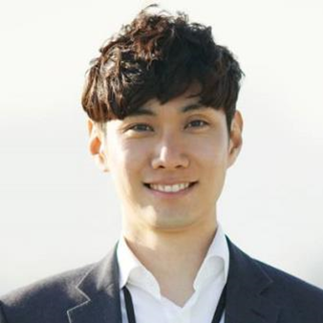
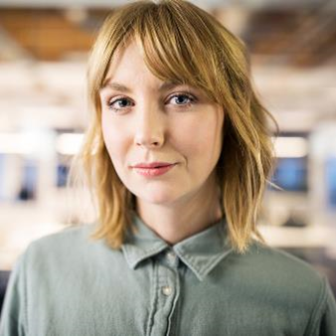
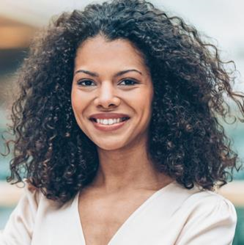
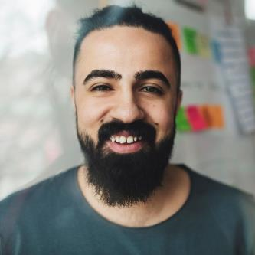
Who do you help?
Student
Girlfriend
Colleague
Classmate
​

Slide 7
In my opinion, you should help every person, however, what do they do you should pay attention to personality of each person, not their position.
“
”
mahdimnkh81​

Slide 8
advantages Of Help
If you help others, you’ll
1- Get a good sense.
2- Grow up self-esteem.
3- Change your vision.
4- Increase your lifespan.
5- Help yourself.
6- have a happy life.
mahdimnkh81​

Slide 9
How can we help other?
1- As much as possible give food and money to people in need
2- Give medical facilities to people in need.
3- Come round and give presents to poor.
4- Give blood
5- Create a place for people who don’t have home.
6- Get a job for people who don’t have a job.
7- when you want to see and talk to a person, at first smile then talk to him or her.
mahdimnkh81​

Slide 10
Summary
In the world, we should increase kindness And
We should help others because it has many profits for us.
mahdimnkh81​

Slide 11
Thank you
Mahdi Mansourikhah
mahdimansourikhah@gmail.com
mahdimnkh81​

